Slide 1
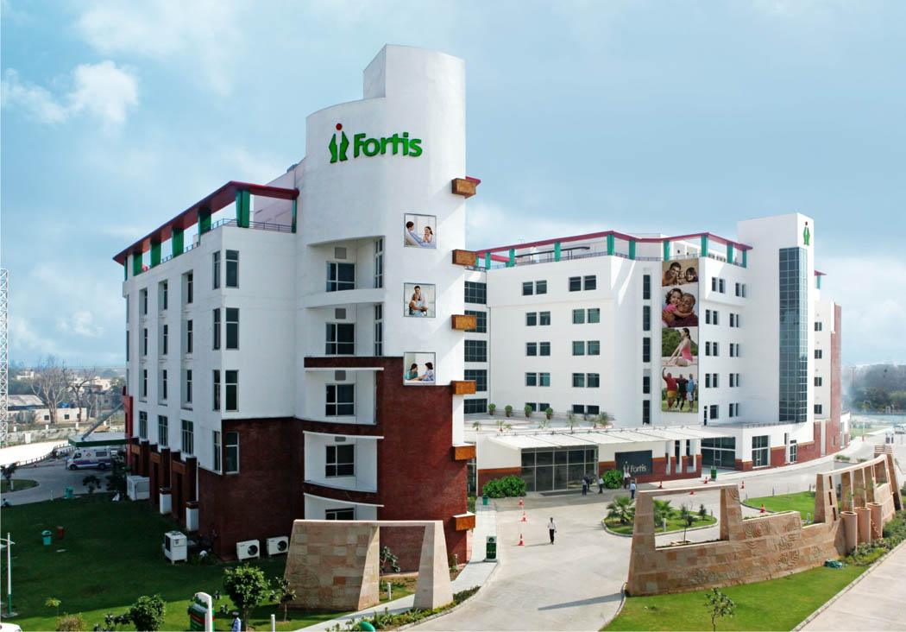

Fortis Hospital ,Shalimar Bagh Delhi

